Slide 1
Leading at the Speed of Change –
Driving Projects Smarter and Faster
Andreea Rasoga

Slide 2





Why I Care About Leading at the Speed of Change
PMO Operations Leader, working on the R&D roadmap of new product innovation programs
Founded and scaled an e-comm business, shaping a deeply hands-on, execution driven leadership style
Completed Stanford LEAD in 2024, with a focus on leading innovation in disruptive environments
Notes:
Hello everyone!
Before we dive in, let me briefly introduce myself and share why this topic is close to my heart.
My name is Andreea Rasoga and I’m a PMO Operations Leader at NXP Semiconductors, where I work on the R&D roadmap of new product innovation programs. My role is all about helping engineering, business, and supplier teams deliver smarter and faster, as priorities and requirements constantly evolve.
Earlier in my career, I built and scaled an e-commerce business from the ground up — an experience that hard-wired a deeply hands-on, execution-oriented mindset.
Last year, I completed the Stanford LEAD program, focused on leading innovation and driving transformation in disruptive, fast-changing environments.
I’m passionate about efficiency and growth, and my core strength is seeing patterns and figuring out how we can streamline and improve. R&D is an extremely dynamic, change-prone environment, and working in a global, cross-functional setup adds to that complexity. But I believe change doesn’t have to be a bottleneck. If we lead it deliberately, we can turn it into an advantage — building it into the process rather than fighting against it.

Slide 3
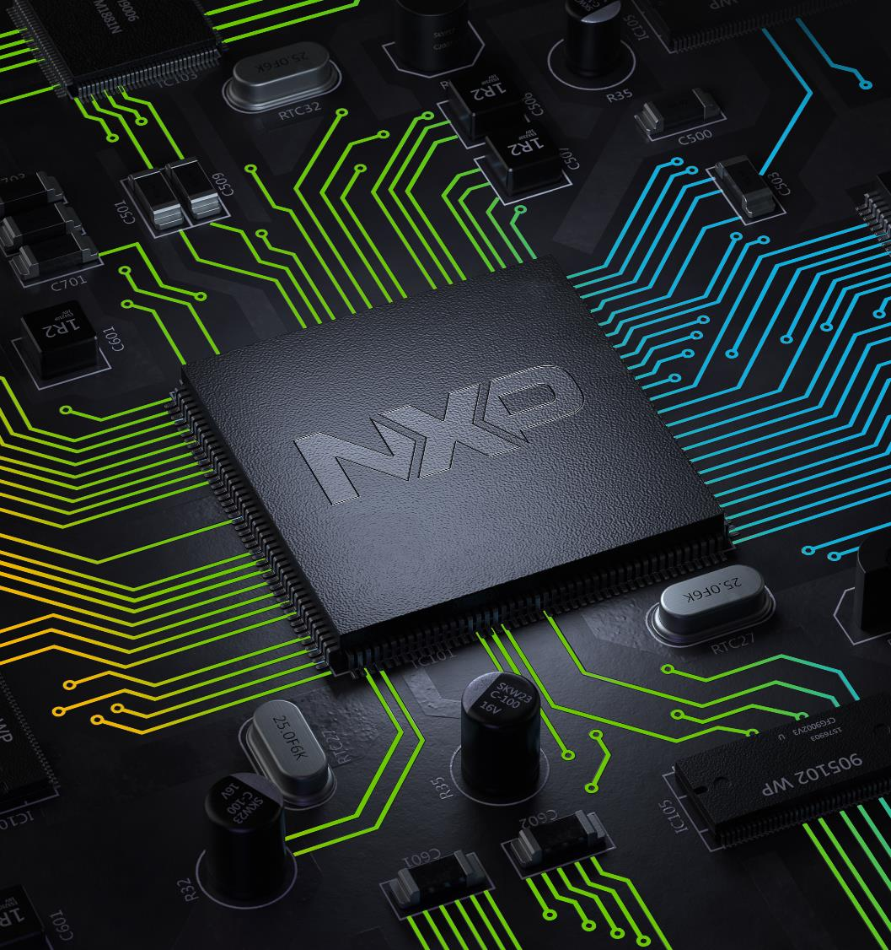
Leading at the Speed of Change
Technology is advancing rapidly – our ability to lead people through change must advance even faster.
Notes:
I want to start by asking you one simple question: I’m curious how many of you, in the past 12 months, have had a project where something changed midstream — a customer request, a supplier issue, a new compliance rule — and that change ended up impacting the schedule?
Exactly. Almost every single one of us / Really, only me? Everyone else’s projects run without issues?
And yet, if we’re honest, most of the systems we use to manage these projects were designed for a world where change was the exception, not the rule.
But that world is gone.
Innovation cycles in semiconductors are shrinking. Technologies that once unfolded over five or more years are now expected to scale in roughly half the time, given by the demands of AI, automotive and edge computing.
At the same time, the EU Chips Act is accelerating major fab investments across Europe, pushing us all to deliver capacity and capability faster than ever before.
But here’s the reality: our biggest delays aren’t happening in cleanrooms or with lithography tools, they’re happening in how we lead people through change.
[CLICK] That’s what I want to talk about today.
Not how to plan better, but how to lead better.
Not how to control change, but how to turn it into a strategic advantage.
Because in this industry, success isn’t just about building faster chips. It’s about building organizations that can move at the speed of change.

Slide 4
The Hidden Bottleneck: Where Semiconductor Projects Lose Speed
Scope ambiguity
Stakeholder resistance
Change
Cost
Debate
Rework
Delay
Late alignment
Decision backlog
Notes:
Now that we’ve acknowledged that change is no longer the exception - it’s the standard we operate by - let’s look more closely at where our projects actually lose speed.
Across dozens of programs, the slowdown tends to follow a familiar pattern.
[CLICK] It starts with a change: a new customer requirement, a shift in supply, an updated standard.
[CLICK] That triggers debate: teams interpret the impact differently, priorities are questioned, and discussions stretch on.
[CLICK] Next comes delay. Decisions don’t arrive as quickly as the project clock moves. Escalations take time. People wait for clarity before taking action.
[CLICK] By the time a decision is made, rework is almost inevitable. Designs are revised, plans reshuffled, schedules adjusted.
[CLICK] And at the end of this loop, costs rise — not because our technology isn’t capable, but because time has slipped away.
If we look beyond this loop, we see the real drivers of friction.
[CLICK] Scope ambiguity — when must-haves and nice-to-haves aren’t clearly defined, change becomes endless.
[CLICK] Decision backlog — when choices queue up for sign-off, velocity drops.
[CLICK] Late alignment — when teams move forward with different interpretations of the same change, rework is built in.
[CLICK] And stakeholder resistance — often not to the change itself, but to the uncertainty and disruption it brings.
These are the moments where momentum leaks away.
And the reason they’re so important is because they rarely show up on a Gantt chart or a dashboard. But they are often the single biggest reason a semiconductor project slips — long before design ever meets manufacturing.

Slide 5
Project Control
The Leadership Gap: Why Traditional Project Management Isn’t Enough
Change Leadership
Track Progress
Enforce Process
Report Status
Shape Direction
Align Mindsets
Enable Velocity
Control builds order.
Leadership builds momentum.
Notes:
Here’s the uncomfortable truth. Most of the frameworks and systems we still use to run semiconductor projects were designed for a very different world — one where predictability was the norm and change was an exception.
They’re excellent at what they were built for: tracking, reporting, controlling. They tell us where we are against the plan. They flag when we’re late. They make sure tasks get ticked off.
But they fall short when the plan itself is changing beneath our feet. Because in a world defined by rapid technology shifts, new customer demands, supply disruptions, and evolving standards, control alone doesn’t create speed.
What we need is something different. We need leadership.
[CLICK]
Leadership is not about enforcing the plan, it’s about shaping direction when the plan changes.
Leadership is not about managing tasks, it’s about aligning mindsets, so people move in the same direction even when conditions shift.
Leadership is not about escalation, it’s about enabling fast, confident decisions at the right level, without waiting for layers of approval.
This is the gap we need to close. We invest in tools, dashboards, and governance, but we need to invest in the capability to lead people through constant change.
And this is where smarter, leaner, faster execution really happens. It’s not about how perfectly we follow an original plan, it’s about how effectively we can mobilize teams, align decisions and keep delivery on track when the plan changes.

Slide 6

From Compliance to Commitment
How Leadership Mobilizes People Around Change
Engagement
Allies
Practice
Collaboration
Change accelerates when alignment, energy and ownership move together.
Mindset
Notes:
Traditional project control isn’t enough anymore. Because leading through change is not about telling people what to do, it’s about mobilizing them. Leadership in this context means turning compliance into commitment -> moving teams from simply following instructions to believing in where they’re going. The real question is: how do we, as leaders, create the conditions for people to lean into change, not resist it?
And that shift doesn’t happen because we write a better plan. It happens because we know how to mobilize engagement, collaboration and mindset. We practice it regularly and we intentionally create allies.
One of the best examples I’ve seen of this comes from outside our industry. Doctors at Great Ormond Street Hospital in London were struggling with errors during patient handovers from surgery to intensive care — a mission-critical moment, just like our product handovers. After observing a Ferrari Formula 1 pit crew, they realized the level of speed and precision they needed already existed, just in a different context.
Pit crews work under constant uncertainty. Every stop is different — conditions on the track change, the car arrives with unexpected issues, and they don’t know exactly what will need attention until the moment it happens. And yet, they deliver in under two seconds. Why? Because they have leadership that prepares them for change — not by removing unpredictability, but by building the systems and habits to handle it.
[CLICK] They invest heavily in practice — regular drills, debriefs, and reviews — the equivalent of our syncs, alignment meetings, and retrospectives.
[CLICK] They strengthen engagement — every person knows exactly how their role contributes to the bigger mission. In R&D, this means connecting each team’s work directly to product goals and customer outcomes, so engineers, validation teams and even suppliers understand how their part impacts the next.
[CLICK] They enable seamless collaboration — every movement is coordinated. In our world, this means tight alignment across functions, so handovers happen without friction and speed doesn’t get lost in translation.
[CLICK] They reinforce the right mindset — pressure is expected, not feared. It means cultivating a culture where iteration is normal, setbacks fuel learning and agility under shifting requirements becomes second nature.
[CLICK] And they rely on allies — trust and shared purpose keep the team moving as one. In semiconductor development, our strongest allies are often suppliers. When we bring them into our plans early and treat them as part of the team, their speed, innovation and insights become our advantage.
[CLICK] Change is constant and we don’t control that. But what we can do is prepare for it, by mobilizing our people with the same intentionality as a Formula 1 pit crew. By aligning engineering with manufacturing, connecting R&D to business priorities and turning suppliers into partners, we build playbooks that make us fast even when conditions change. That’s how change stops being a bottleneck and becomes a competitive advantage.

Slide 7


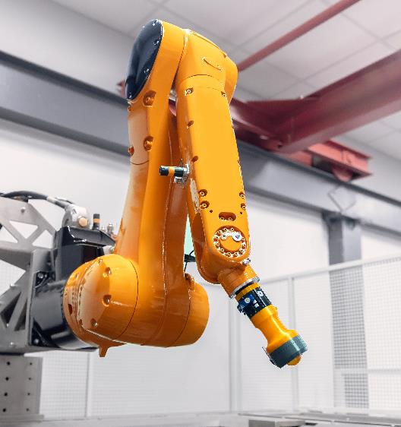

The Four Leadership Moves:
A Framework to Run Projects Smarter and Faster under constant change
Sense
Translate
Anticipate shifts before they hit
Create shared clarity
Decide
Embed
Drive rapid decisions
Make change stick
Notes:
If change is the landscape we operate in, and if practice, engagement, collaboration, allies and mindset are what unleash momentum, then the question becomes: what is the framework to run smarter and faster projects in this constant changing environment?
As leaders in semiconductor projects, we’re asked to navigate shifts without losing speed. I believe there are four leadership moves that make the difference between reacting to change and using it as a competitive edge.
[CLICK] First, Sense. Great leaders don’t just react – we anticipate. We need to build mechanisms to detect change early: weak signals from suppliers, evolving standards, emerging customer needs. We need to create space for challenge and foresight, so our teams see around corners before the disruption arrives.
[CLICK] Then we have to Translate – to turn complexity into shared understanding. Great leaders need to align business language with engineering reality, customer priorities with technical trade-offs. They help everyone see not just what changed, but why — and whether it’s a must-have or a nice-to-have.
[CLICK] Third, we need to Decide fast and shorten the gap between knowing and doing. Our processes enable fast, confident decisions and we measure decision velocity because that’s where real speed comes from.
[CLICK] finally, we Embed. We need to make sure change sticks and that it becomes part of how we work, not just the exception.
Together, these four moves form a continuous cycle – a way for us to lead projects through change and running projects smarter, leaner and faster, even as the environment keeps shifting.

Slide 8



The Acceleration Moves
Sense
Translate
Decide
Cross-function syncs to surface shifts
Track weak signals in project reviews
Apply learnings to prevent repeat risk
Reframe change in business and customer terms
Connect the WHY to goals – across teams & suppliers
Define clear outcomes and ownership
Map project specific RACI at kickoff
Keep decision forums small and focused
Track and review decision lead times to unblock delays
Resolve before risks transform into delays
Clarity drives focused execution
Keep momentum and accelerate execution
Notes:
Lets dive deeper into the first three pillars, because these are the ones that build momentum before change ever becomes a slowdown.
[CLICK] Change rarely arrives as a headline. It begins as weak signals and our job is to see it before it hits. We do that by surfacing signals early in weekly cross-function syncs, by tracking them systematically in project reviews, and by capturing lessons learned so the same risk doesn’t show up twice. That’s how we resolve issues before they turn into delays.
[CLICK] Once we sense a shift, we have to make sure everyone understands why it matters and how it connects to their work.
This is where we translate change into shared clarity — reframing it in business or customer terms, linking the “why” to each team’s objectives, and defining concrete outcomes and ownership. And it’s not just internal alignment – we bring suppliers into that same conversation early, treating them as part of the team. When everyone speaks the same language and pulls in the same direction, execution accelerates instead of stalling.
[CLICK] Then it’s time to decide — because momentum dies when decisions stall. This is where clarity turns into speed.
We map a project-specific RACI right from kickoff so everyone knows exactly who decides. We keep decision forums small and focused, to cut decision time. And we track and regularly review decision velocity. That’s how we keep momentum alive and projects moving forward.
So by sensing early, translating clearly, and deciding fast we shift from reacting to change, to shaping it. It’s how we build speed at the front end of the project, so that when disruption comes, we’re already moving.

Slide 9
Embed – Where Change Becomes Culture
Integrate RCA & learnings into new standards
Set decision paths & ownership early
Reward calculated risk taking
Change as
Culture
Notes:
Everything we’ve done up to this point only matters if it sticks. Too often, change efforts fade because they never become part of how we work every day.
[CLICK] The first step is to capture and bake in what we’ve learned, but it’s also to filter. Not every signal deserve a reaction. Part of embedding is sharpening our sensitivity to what truly matters vs what’s just noise. That’s were structured root cause analysis and systemic improvements come in: we don’t just fix isolated issues, we fold those learnings into new standards and ways of working so each project starts stronger.
[CLICK] Second, we define decision pathways early and empower teams. That means clarifying not only who makes which decisions, but also which risks can be handled at each level — so momentum doesn’t stall waiting for approvals.
[CLICK] Finally, we reward smart risk-taking. We encourage teams to fail fast and learn quickly, instead of punishing calculated risks.
[CLICK] That mindset shift is what transforms change from a disruption into a muscle — part of our culture, not an exception to it. It’s about continuously adapting so we can accelerate. And that’s how we make sure future projects run with greater resilience.

Slide 10
Leading at the Speed of Change
Sense
Early
Translate
Clearly
Decide
Faster
Embed
Deeply
Smarter. Leaner. Faster.
Change is inevitable. Velocity is a choice.
Notes:
I want to leave you with one core message: change is not the challenge. How we lead through it is.
Semiconductor innovation is only moving faster. EU investments are intensifying. Competition is tighter. Complexity is growing. This is our reality.
But speed isn’t about more tools, more processes, or bigger teams. It’s about leadership. It’s about how we sense what’s coming, translate change so people rally behind it, decide with clarity and confidence, and embed those decisions until they become part of how we operate.
[CLICK] That’s how we lead projects and people - smarter, leaner, and faster. And that’s how we build the future of this industry, together.

